Slide 1
Suicide, overdose, and worker exit
in a cohort of Michigan autoworkers
Ellen Eisen, ScD and Kevin Chen, MPH
and H Elser, S Picciotto, S Dufault, S Goldman-Mellor, J Cohen

Slide 2
Background
In the past 20 years, mortality due to drug overdose and suicide has increased in the US across all age, race/ethnicities
Increase in “deaths of despair” related to increased drug supply and reduced economic opportunity, especially for noncollege adults (≤ HighSchool diploma)
Job loss (Involuntary worker exit) found to have substantial effects on depressive symptoms, even after adjusting for baseline health

Slide 3
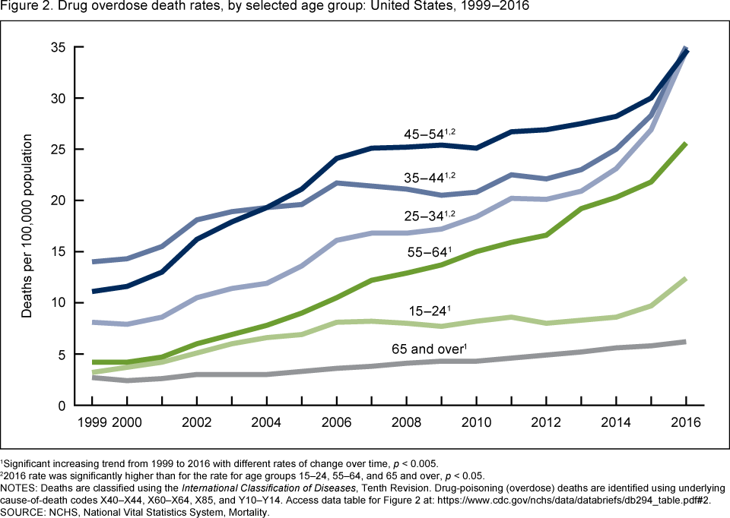
Notes:
Youngest person in the entire cohort was born in 1961

Slide 4
Notes:
Biggest increases from 1999 to 2016 in middle ages 45-65

Slide 5
Decline in US manufacturing
In the 1970s, 36% of all US male workers were employed in manufacturing - in 2018, only 15% of US male workers were.
For those without a college degree, good-paying jobs with strong employer-employee relationships and job security have declined and precarious work has increased

Slide 6
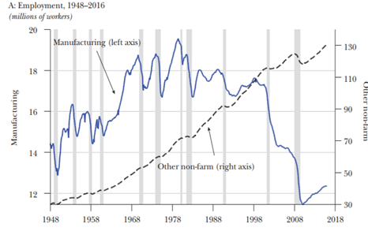
Notes:
In millions (not %)

Slide 7
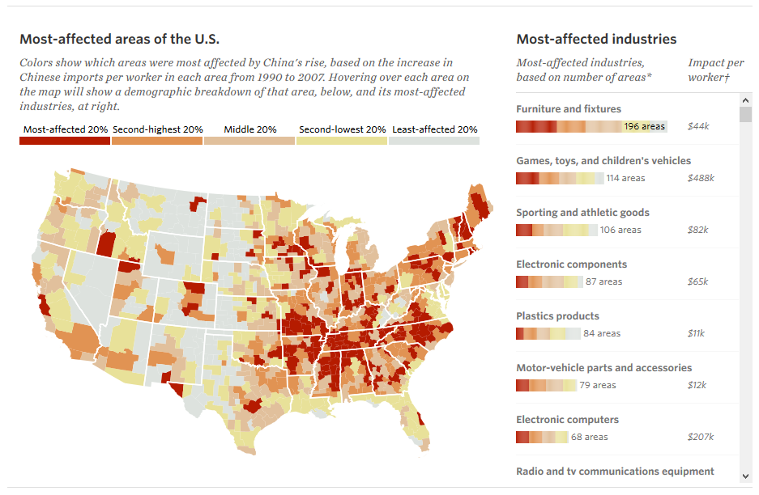
China Shock: All industries
Notes:
China’s entry into the World Trade Organization in 2001 allowed Chinese imports to flood US markets, thereby contributing to industry contraction

Slide 8
Case Study: US automobile industry
Striking case study of an impacted industry in decline
China shock
Oil embargo of 1979
Hybrids
Stronger vehicle safety regulations
Increasing oil prices
By 2008, Toyota became the largest automaker in the world, a title GM held for 77 years

Slide 9
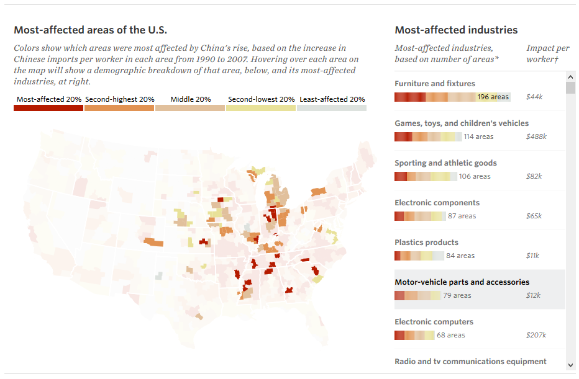
China Shock: Motor-vehicle parts & accessories
Notes:
http://chinashock.info/

Slide 10
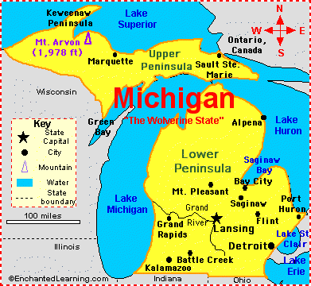
The UAW-GM Cohort Study
Study of the Health Effects of Metalworking Fluids -1985
Jointly funded by General Motors and UAW union
Includes all workers at 3 GM manufacturing facilities:
Urban center of Detroit
Township, 50 miles west of Detroit
Small city upstate, once a thriving lumber and manufacturing center

Slide 11

Post-doc involved in the original study design and field work

Slide 12
United Autoworkers-General Motors Cohort (UAW-GM)
Large cohort of 48,000 Michigan autoworkers with individual-level data
All workers ever employed at the 3 plants who worked ≥ 3 yrs
1938< Hired < 1983
Original mortality follow-up 1941 to 1985
Mortality follow-up extended every 10 years (NIOSH funding)
Mostly white men but ~20% women and 15% African American

Slide 13
Health Effects of long term exposure to metalworking fluids (MWF)
Composed of petroleum based mineral oils, chemical additives
Sprayed to lubricate and cool metals parts during machining operations
Quantitative retrospective exposure assessment
10-year mortality follow-ups from 1985 to 2015 all funded by NIOSH
Dozens of papers have been published linking cancers to long term exposure to MWF applying g-methods to address HWSE
Prostate cancer, female breast cancer, bladder and stomach cancer, and melanoma skin cancer
Notes:
My research over the past 30 years involved
Hammond part of exposure assessment team

Slide 14
Suicide, overdose, and worker exit in the UAW-GM Cohort study
Focus on the period after late 1970s to capture accelerated decline of the domestic industry
UAW-GM Cohort restricted to subjects still employed in 1970
By the end of follow-up in 2015, all 3 study plants had closed

Slide 15
Methods
Exposure: Worker exit measured in two ways
Time-varying employment status (active versus inactive)
Age at worker exit, to distinguish retirement (left work at age 55 or older) from earlier worker exit
Outcome: vital status and cause of death obtained through the National Death Index, company records, death certificates, and state mortality files
Suicide alone
Suicide and Fatal overdose combined

Slide 16
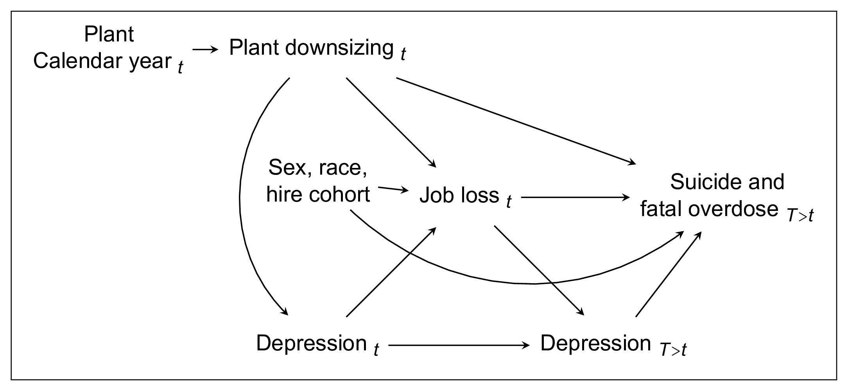
DAG illustrating our assumptions

Slide 17
Analytic method
Adjusted hazard ratios estimated in Cox proportional hazards models
Controlled for age, race, plant, year of hire, and calendar year of follow-up
Depression, a time varying confounder of job loss and suicide, was not measured

Slide 18
Model 1: Exposure = binary employment status
Follow-up starts 3 years after hire or January 1, 1970 (minimum)
Follow-up ends at death, loss to follow-up, or administrative end of follow-up on December 31, 2015
Censor subjects still employed on December 31, 1994
Cox model with age as time metric
Included covariates: race, plant, year of hire, and a time-dependent penalized spline function of calendar year of follow-up

Slide 19
Model 2: with Categorical age at worker exit
Follow-up starts the day after worker exit
Follow-up ends at death, loss to follow-up, or administrative end of follow-up on December 31, 2015
Exclude subjects still employed on Dec 31, 1994
Time since worker exit as time metric
Included covariates: race, plant, and a time-dependent penalized spline function of calendar year of worker exit

Slide 20
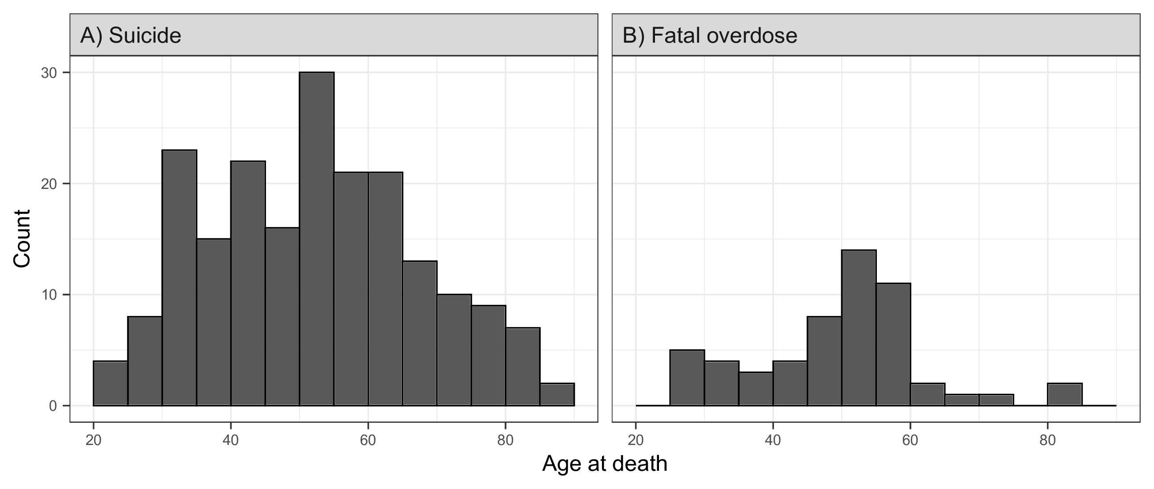
Age at death
eFigure 2. Histograms of age at death among suicide and fatal overdose cases in the UAW-GM Cohort restricted to men employed in or after 1970.

Slide 21
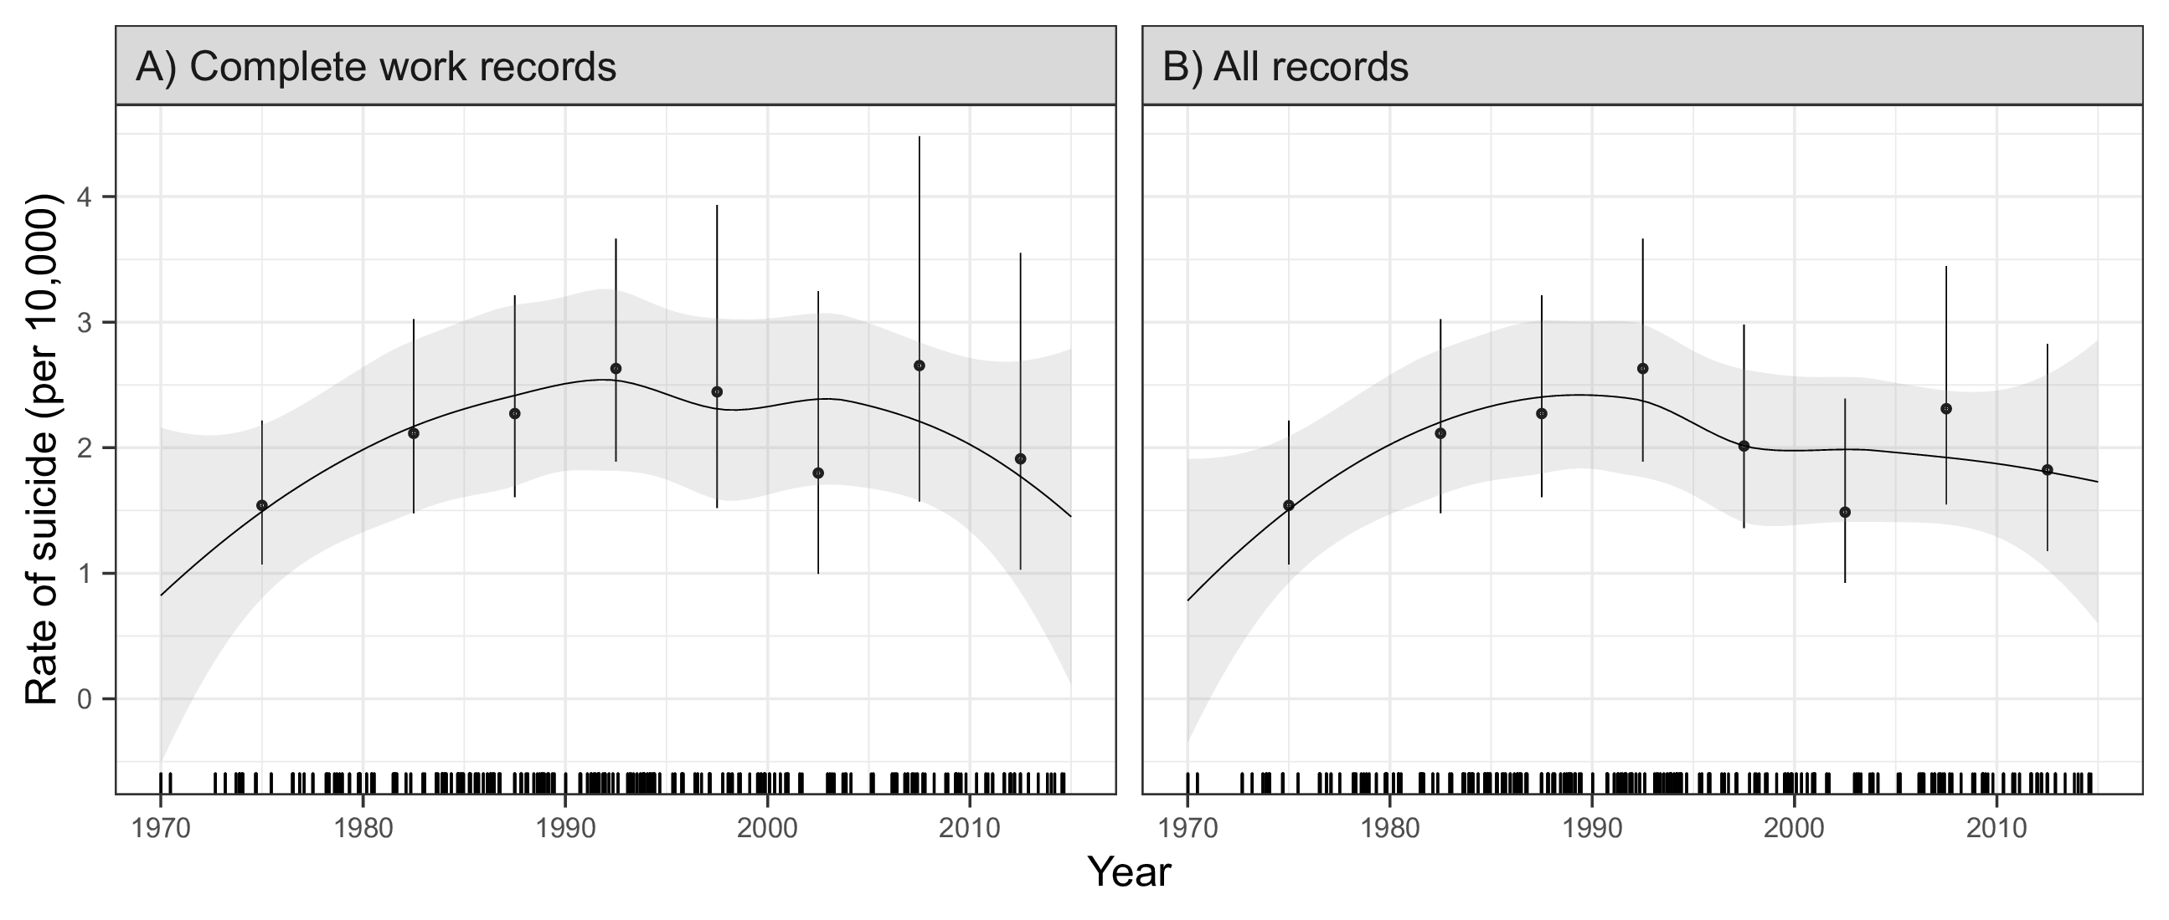
Results: Crude rate of suicide
Figure 1. Crude rate (per 10,000 person-years) of suicide by calendar year in the UAW-GM Cohort restricted to men employed in or after 1970.

Slide 22
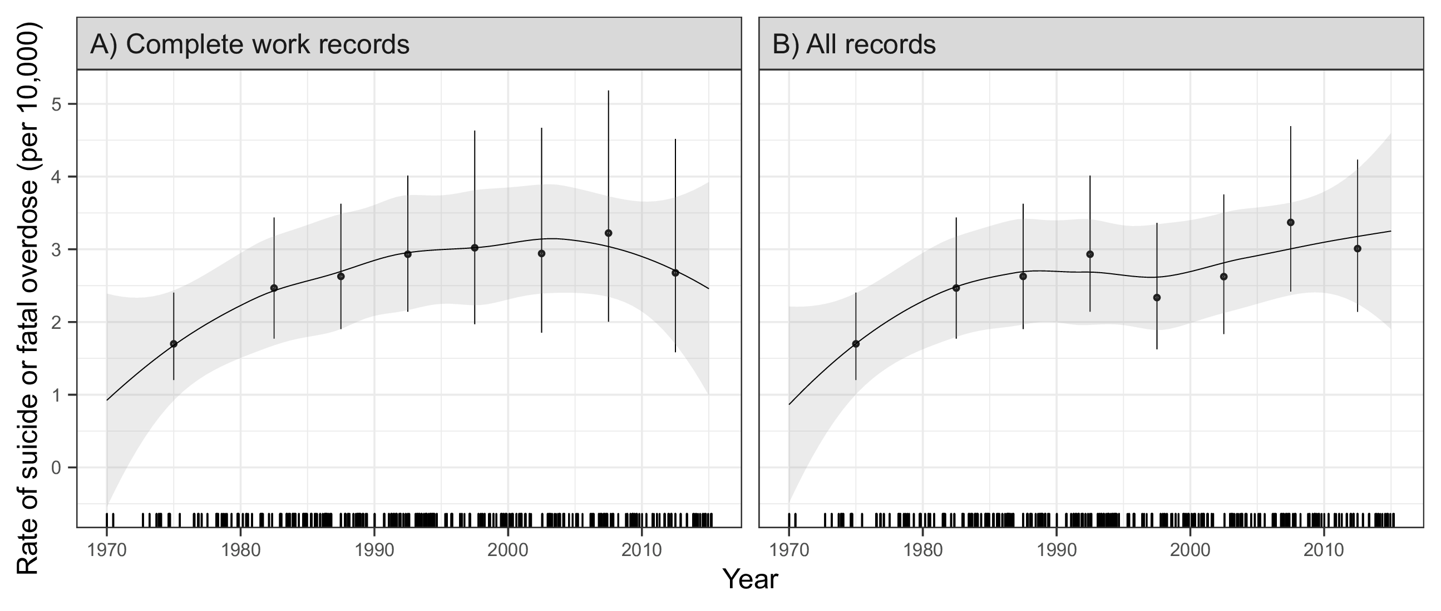
Results: Crude rate of suicide & fatal overdose
Figure 2. Crude rate (per 10,000 person-years) of the combined outcome of suicide and fatal overdose by calendar year in the UAW-GM Cohort restricted to men employed in or after 1970.

Slide 23
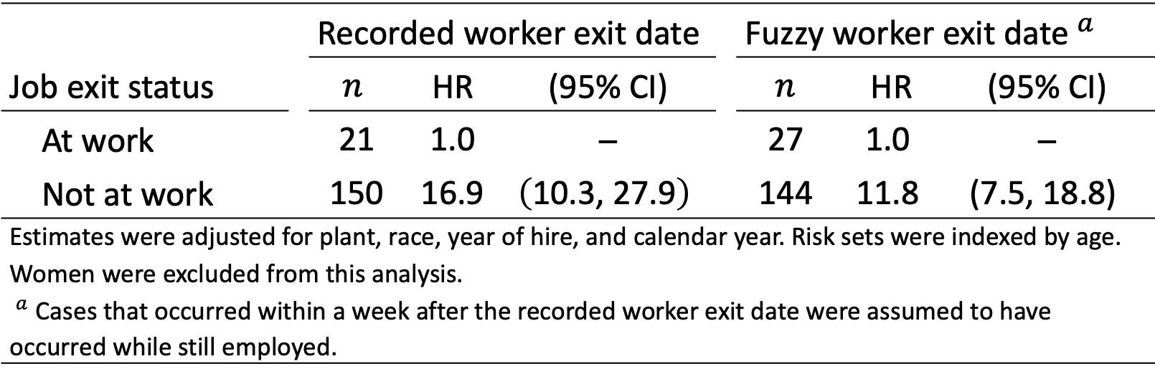
Results: By binary employment status
Table 2. Adjusted hazard ratio estimates for suicide by employment status in the UAW-GM Cohort restricted to men employed in or after 1970.
 |  | Recorded worker exit date |  |  |  | Fuzzy worker exit date${​ }^{a}$
Job exit status |  | $$n$$ | HR | (95% CI) |  | $$n$$ | HR | (95% CI)
At work |  | $$\text{21}$$ | $$\text{1.0}$$ | – |  | $$\text{27}$$ | $$\text{1.0}$$ | –
Not at work |  | $$\text{15}\text{0}$$ | $$\text{1}\text{6.9}$$ | $$\left(\text{10.}\text{3}\text{, 2}\text{7}\text{.}\text{9}\right)$$ |  | $$\text{1}\text{44}$$ | $$\text{1}\text{1}\text{.}\text{8}$$ | $$\text{(7.}\text{5}\text{, 1}\text{8}\text{.}\text{8}\text{)}$$
Estimates were adjusted for plant, race, year of hire, and calendar year. Risk sets were indexed by age. Women were excluded from this analysis. ${​ }^{a}$ Cases that occurred within a week after the recorded worker exit date were assumed to have occurred while still employed.

Slide 24
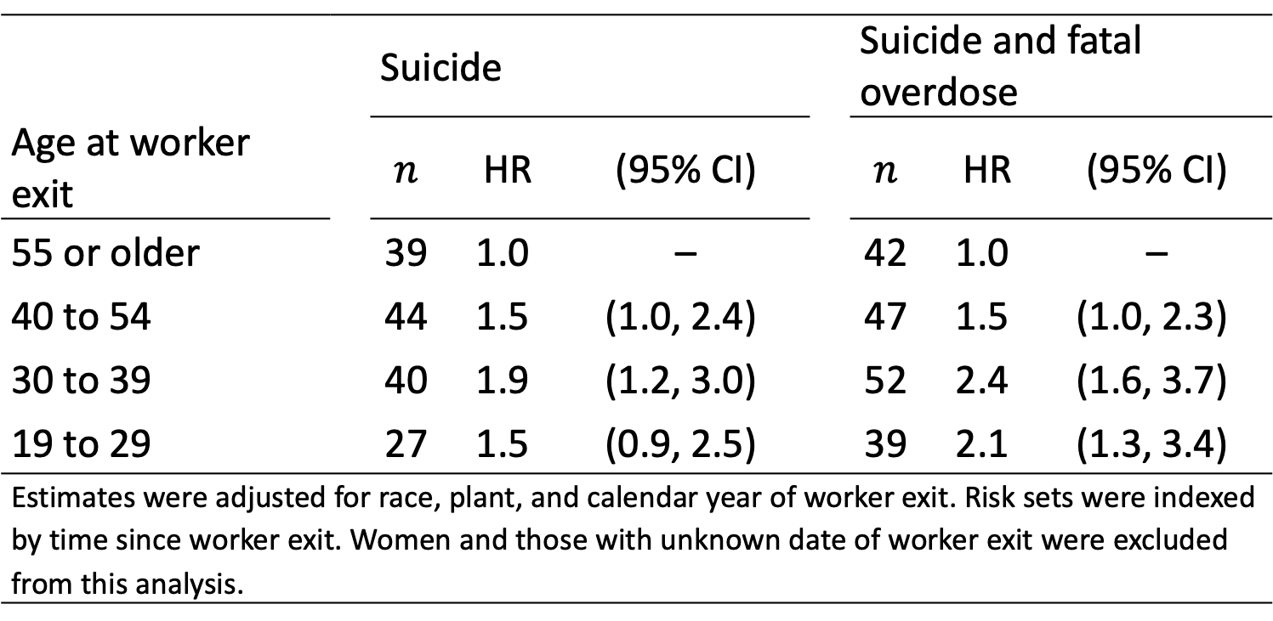
Results: By age at worker exit
Table 3. Adjusted hazard ratio estimates for suicide and the combined outcome of suicide and fatal overdose in the UAW-GM Cohort restricted to men employed in or after 1970.
 |  | Suicide |  |  |  | Suicide and fatal overdose
Age at worker exit |  | $$n$$ | HR | (95% CI) |  | $$n$$ | HR | (95% CI)
$\text{55}$ or older |  | $$\text{39}$$ | $$\text{1.0}$$ | – |  | $$\text{4}\text{2}$$ | $$\text{1.}\text{0}$$ | –
$\text{40}$ to $\text{54}$ |  | $$\text{44}$$ | $$\text{1.}\text{5}$$ | $$\text{(}\text{1.0}\text{, }\text{2.4}\text{)}$$ |  | $$\text{47}$$ | $$\text{1.}\text{5}$$ | $$\text{(}\text{1.0}\text{, }\text{2.3}\text{)}$$
$\text{30}$ to $\text{39}$ |  | $$\text{4}\text{0}$$ | $$\text{1.}\text{9}$$ | $$\text{(1.}\text{2}\text{, }\text{3.0}\text{)}$$ |  | $$\text{5}\text{2}$$ | $$\text{2.}\text{4}$$ | $$\text{(1.}\text{6}\text{, 3.}\text{7}\text{)}$$
$\text{19}$ to $\text{29}$ |  | $$\text{27}$$ | $$\text{1.}\text{5}$$ | $$\text{(0.}\text{9}\text{, 2.}\text{5}\text{)}$$ |  | $$\text{3}\text{9}$$ | $$\text{2.}\text{1}$$ | $$\text{(1.}\text{3}\text{, 3.}\text{4}\text{)}$$
Estimates were adjusted for race, plant, and calendar year of worker exit. Risk sets were indexed by time since worker exit. Women and those with unknown date of worker exit were excluded from this analysis.

Slide 25
Sensitivity analyses
Assumed that those who died of suicide within a week after the recorded worker exit date died while still employed
Account for possible “back-coding” of worker exit dates for those who died suddenly
Limited follow-up to no more than 5 years after the worker exit date
Account for confounding by age and the potential for competing risks

Slide 26
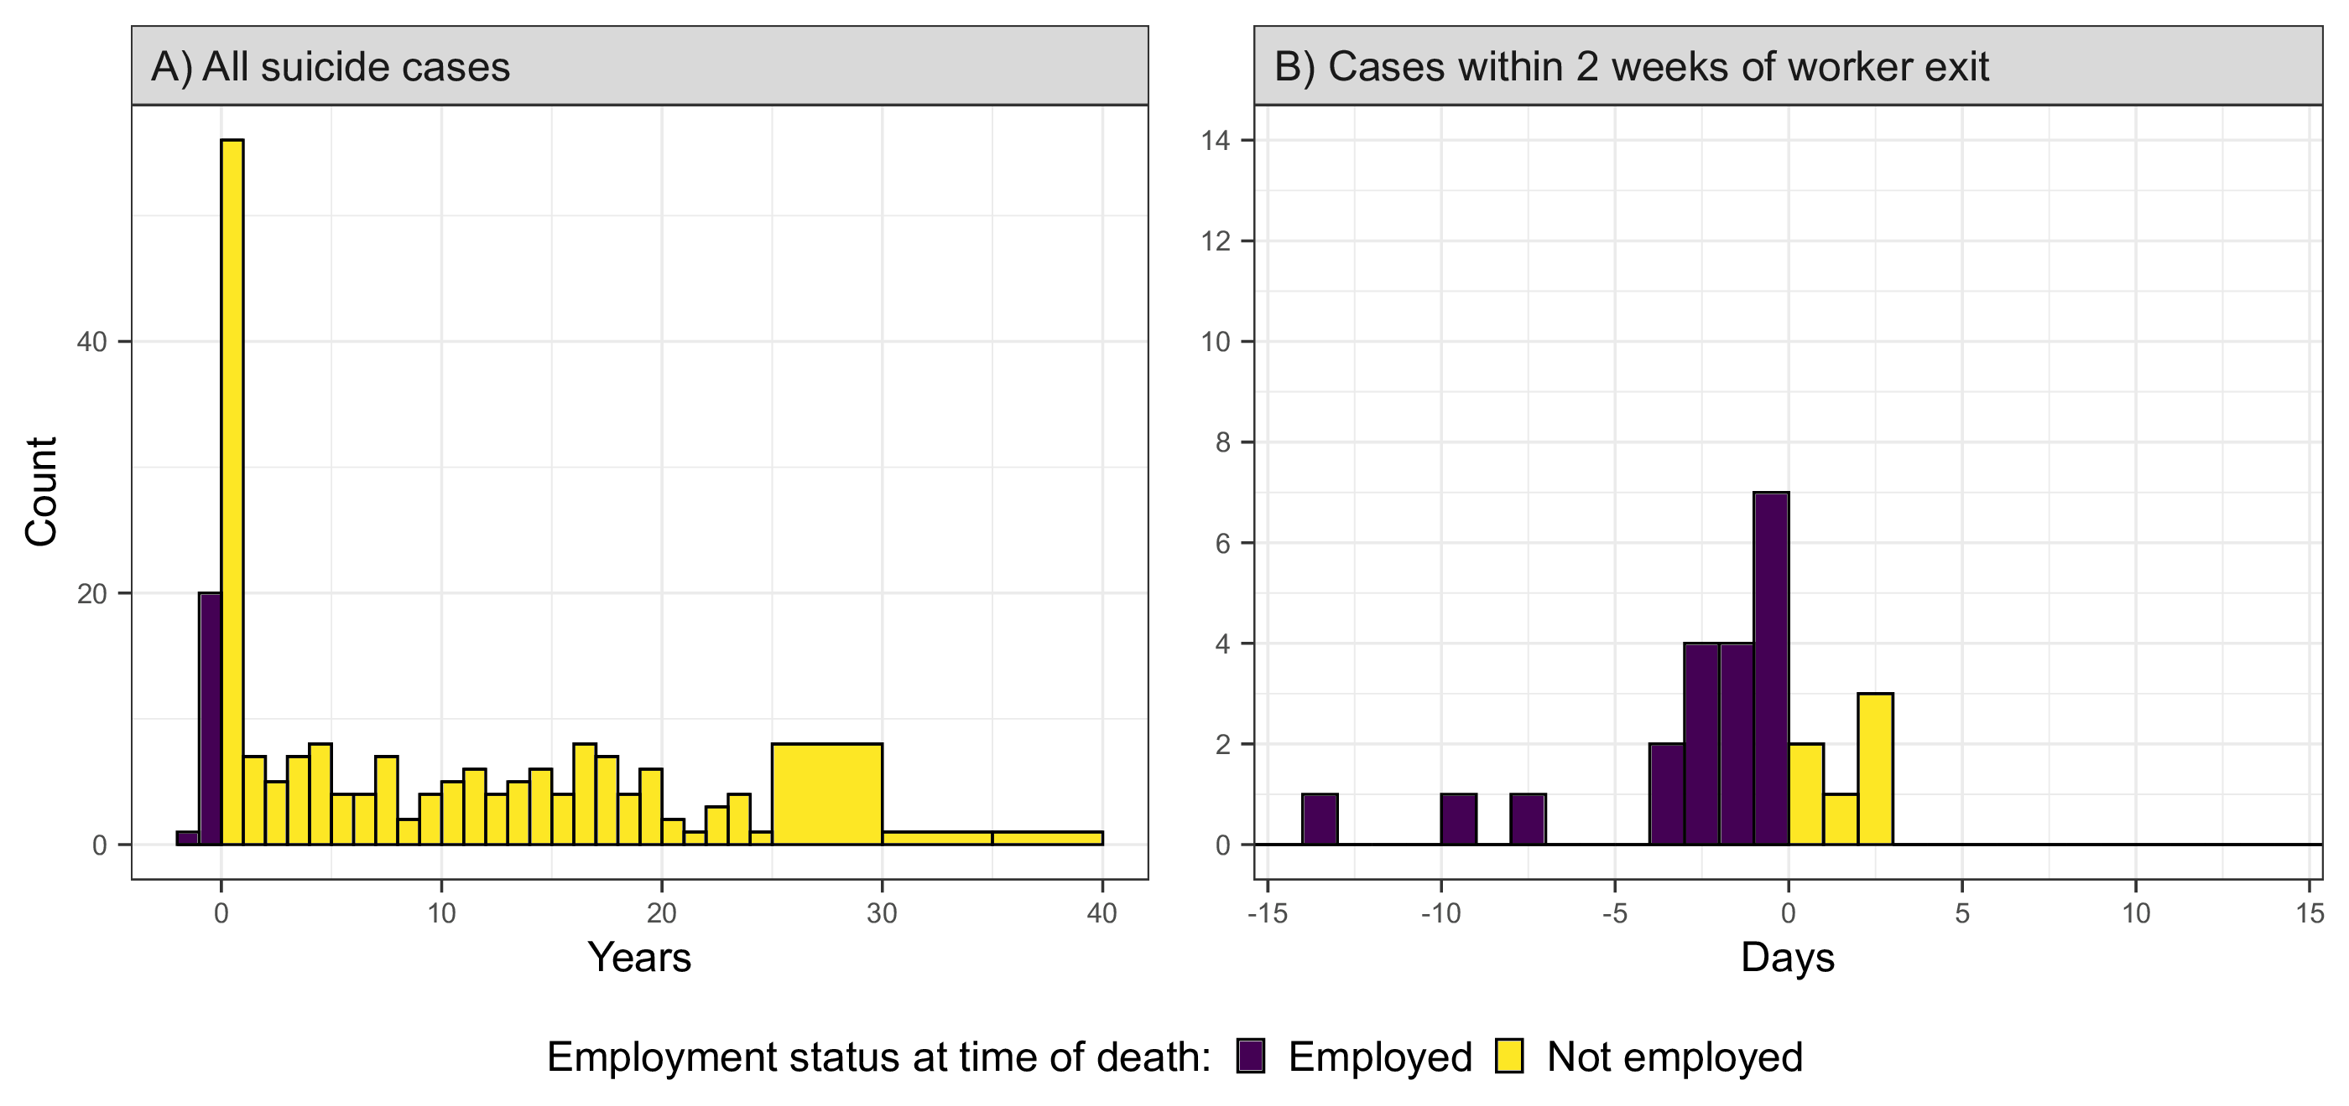
Additional materials: Fuzzy dates
eFigure 3. Histograms of time between worker exit date and date of suicide in the UAW-GM Cohort restricted to men employed in or after 1970. Bins corresponding to cases that occurred while employed are indicated in purple.

Slide 27
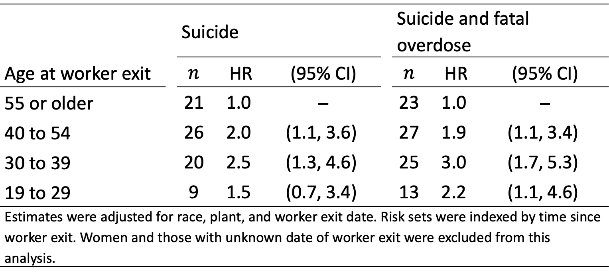
Additional materials: Restricted follow-up
eTable 1. Adjusted hazard ratio estimates for suicide and the combined outcome of suicide and fatal overdose in the UAW-GM Cohort, within five years of worker exit, restricted to men employed in or after 1970 who left work by December 31, 1994.
 |  | Suicide |  |  |  | Suicide and fatal overdose
Age at worker exit |  | $$n$$ | HR | (95% CI) |  | $$n$$ | HR | (95% CI)
$\text{55}$ or older |  | $$\text{2}\text{1}$$ | $$\text{1.0}$$ | – |  | $$\text{23}$$ | $$\text{1.0}$$ | –
$\text{40}$ to $\text{54}$ |  | $$\text{2}\text{6}$$ | $$\text{2.0}$$ | $$\text{(}\text{1.1}\text{, }\text{3.6}\text{)}$$ |  | $$\text{2}\text{7}$$ | $$\text{1.}\text{9}$$ | $$\text{(}\text{1.1}\text{, }\text{3.4}\text{)}$$
$\text{30}$ to $\text{39}$ |  | $$\text{2}\text{0}$$ | $$\text{2.5}$$ | $$\text{(1.}\text{3}\text{, }\text{4.6}\text{)}$$ |  | $$\text{2}\text{5}$$ | $$\text{3}\text{.0}$$ | $$\text{(1.}\text{7}\text{, }\text{5.3)}$$
$\text{19}$ to $\text{29}$ |  | $$\text{9}$$ | $$\text{1.}\text{5}$$ | $$\text{(0.}\text{7}\text{, }\text{3.4}\text{)}$$ |  | $$\text{13}$$ | $$\text{2.2}$$ | $$\text{(}\text{1.1}\text{, }\text{4.6}\text{)}$$
Estimates were adjusted for race, plant, and worker exit date. Risk sets were indexed by time since worker exit. Women and those with unknown date of worker exit were excluded from this analysis.

Slide 28
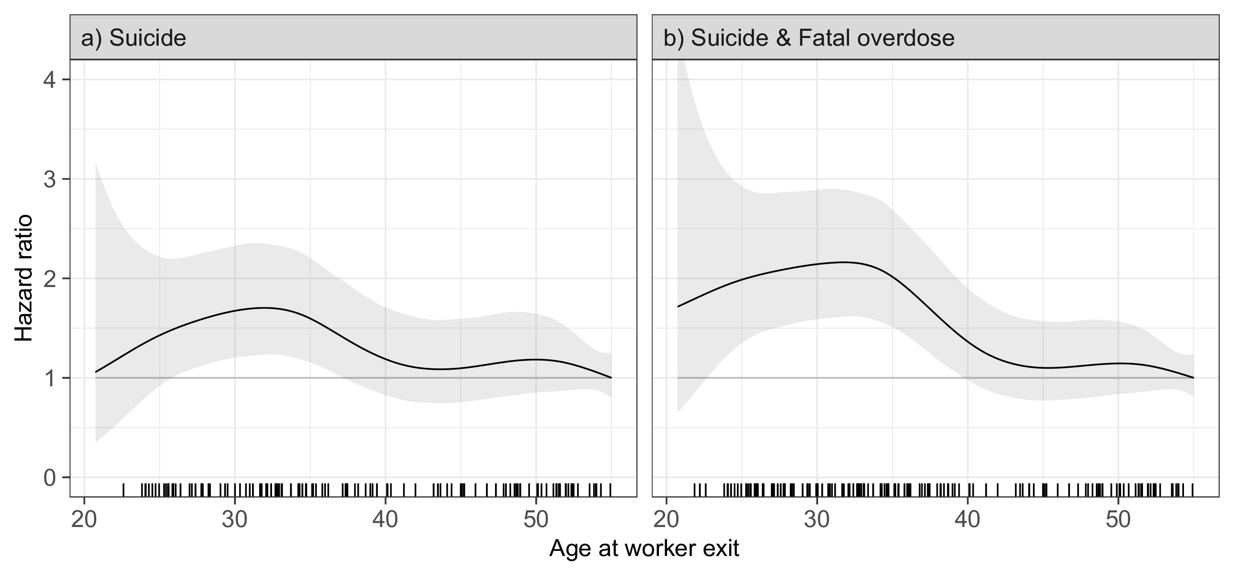
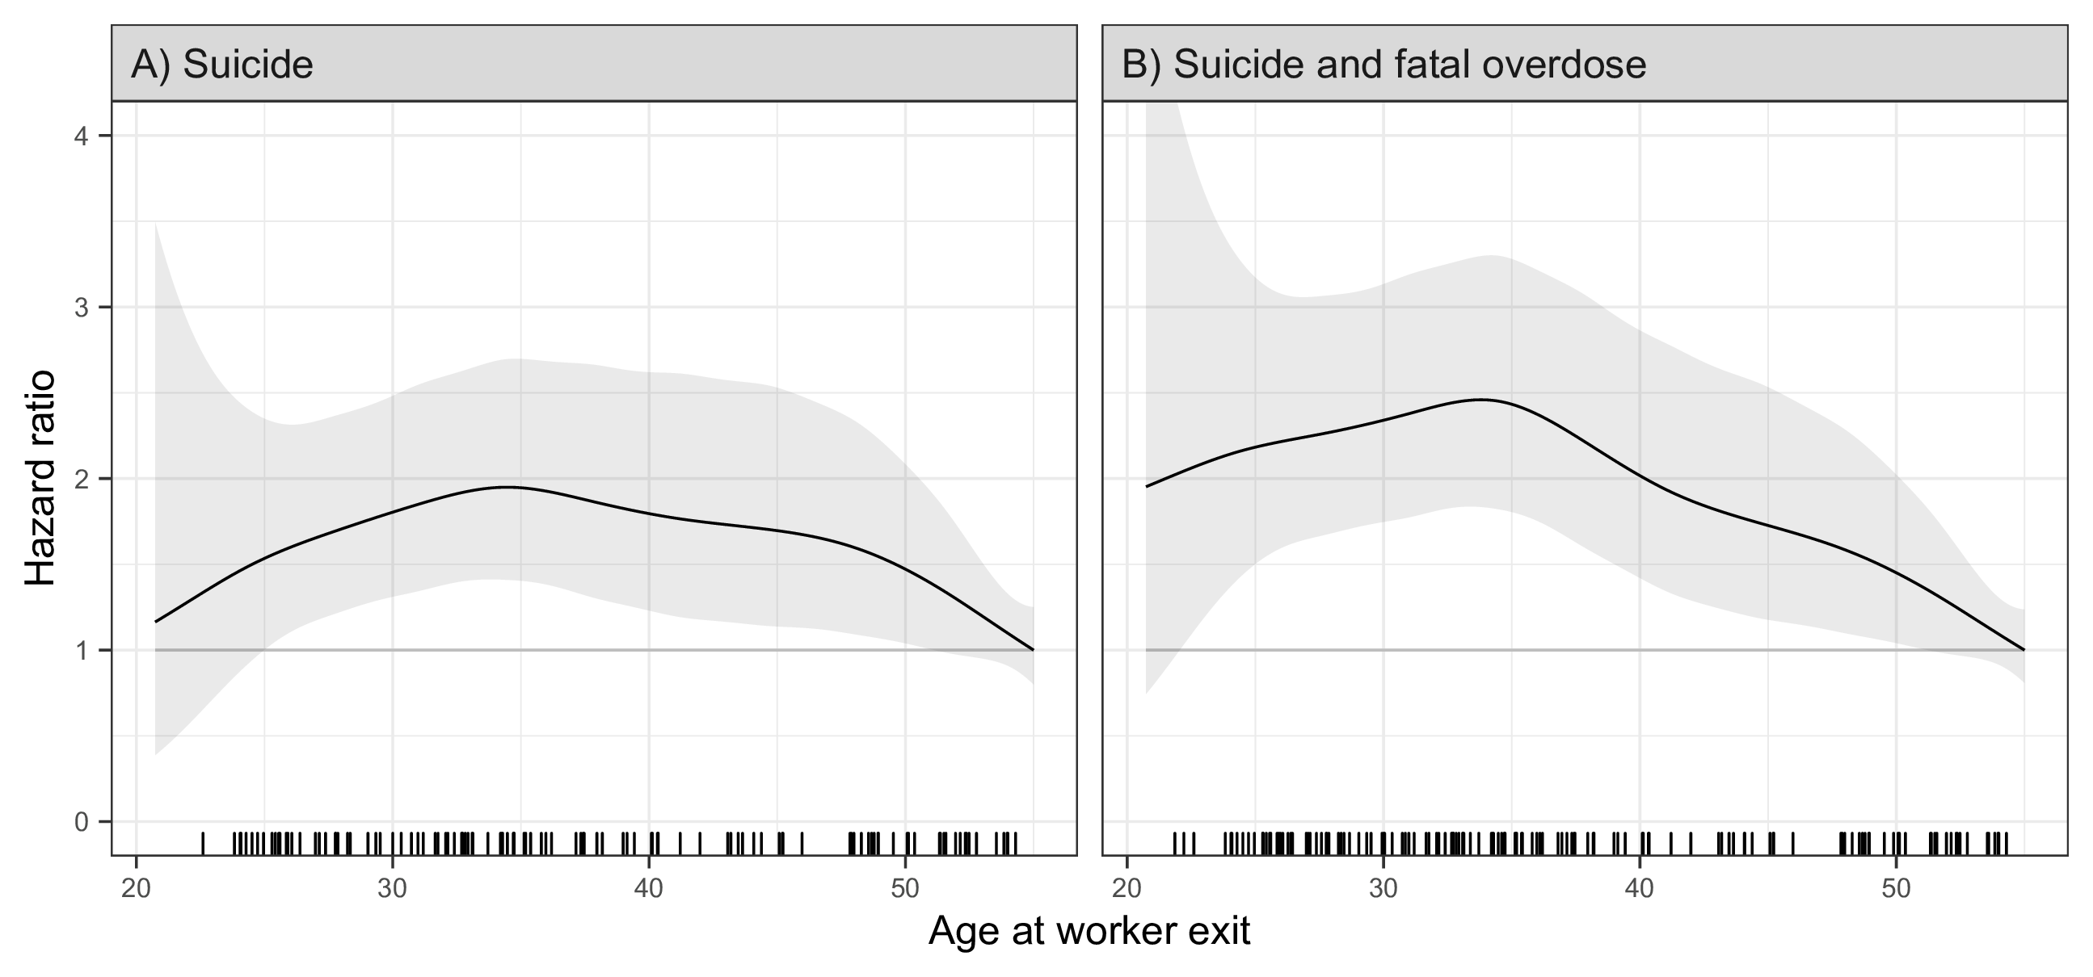
Additional materials: Spline fits
eFigure 4. Continuous adjusted hazard ratio estimates for suicide and the combined outcome of suicide and fatal overdose in the UAW-GM Cohort restricted to men employed in or after 1970.

Slide 29
Conclusions
Michigan autoworkers who left work after 1970 had a higher risk of death from suicide or overdose than those who remained actively employed
Most events occurred within 5 years of leaving work among those who left before retirement age
These findings suggest that involuntary job loss may lead to suicide and fatal overdose

